Slide 1
EduLoyalty
Reward Point System
</
/>
Presenting = (“ Parisha Desai ”,
“ Prasad Mahabare ”,
“ Shruthi Mandaokar ”,
“ Suparshwa Patil ”)

Slide 2

</Project Overview
Objective:
  Encourage Active Participation
  Improve Student Engagement
End Users:
  Students(Prospective and Returning)
  Faculty
  Admin Staff
Purpose:
  Front End and Back End Integration
  Implement ETL

Slide 3
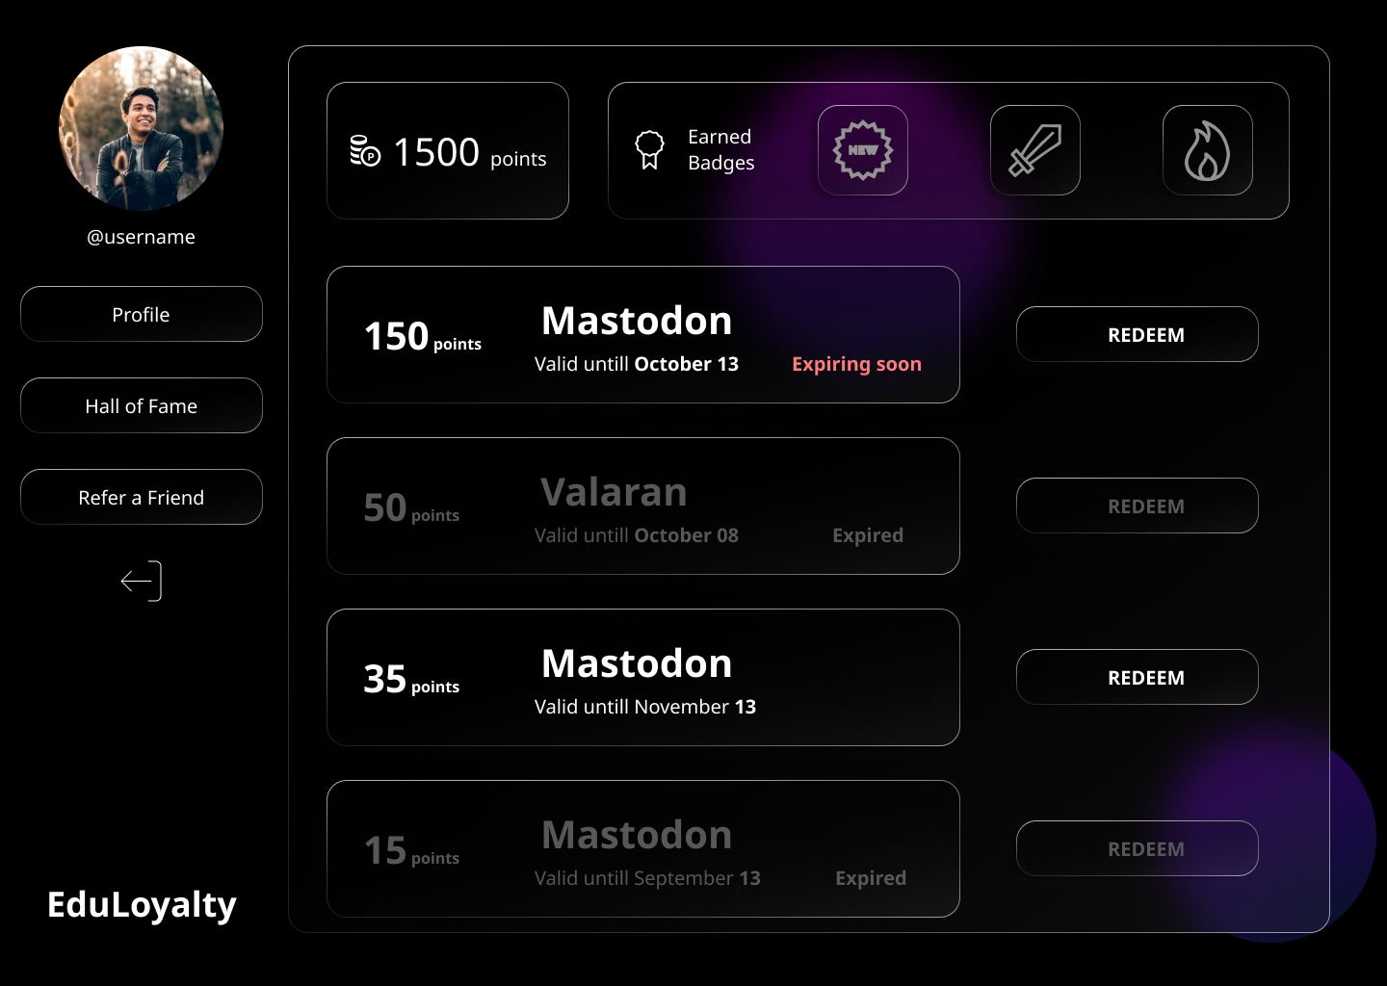
</Requirements
Functional
Sign Up
Dashboard
Points
Coupons
Hall of Fame
Refer a friend
Non-Functional
Security
Interpretability
Responsive
Maintainability
User logs

Slide 4
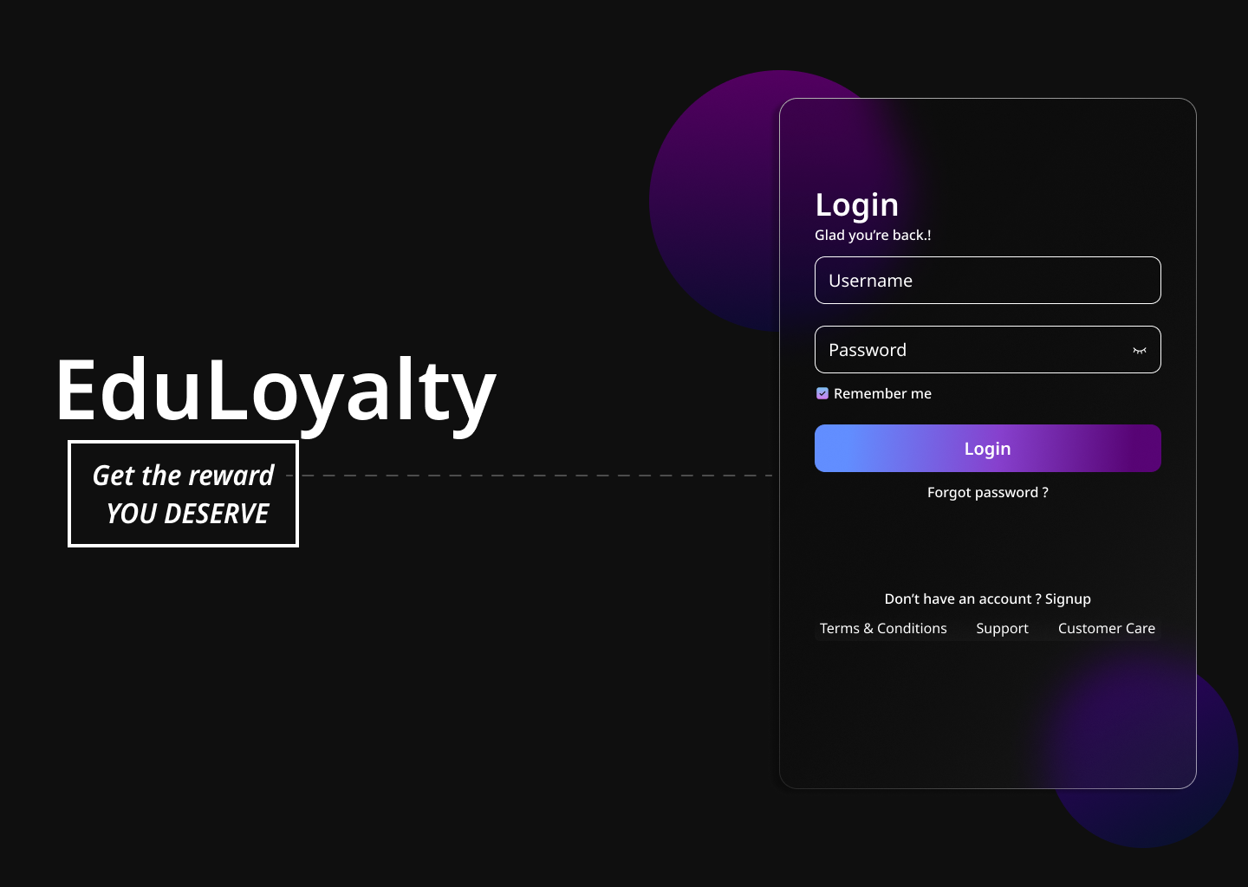

</Requirements
Nice to have
Extension
Purdue Domain

Slide 5



</System Architecture
User Interface (React)
Middleware (REST API)
Back End
DB
(MySQL)
Web
Services
Python
Django Framework

Slide 6
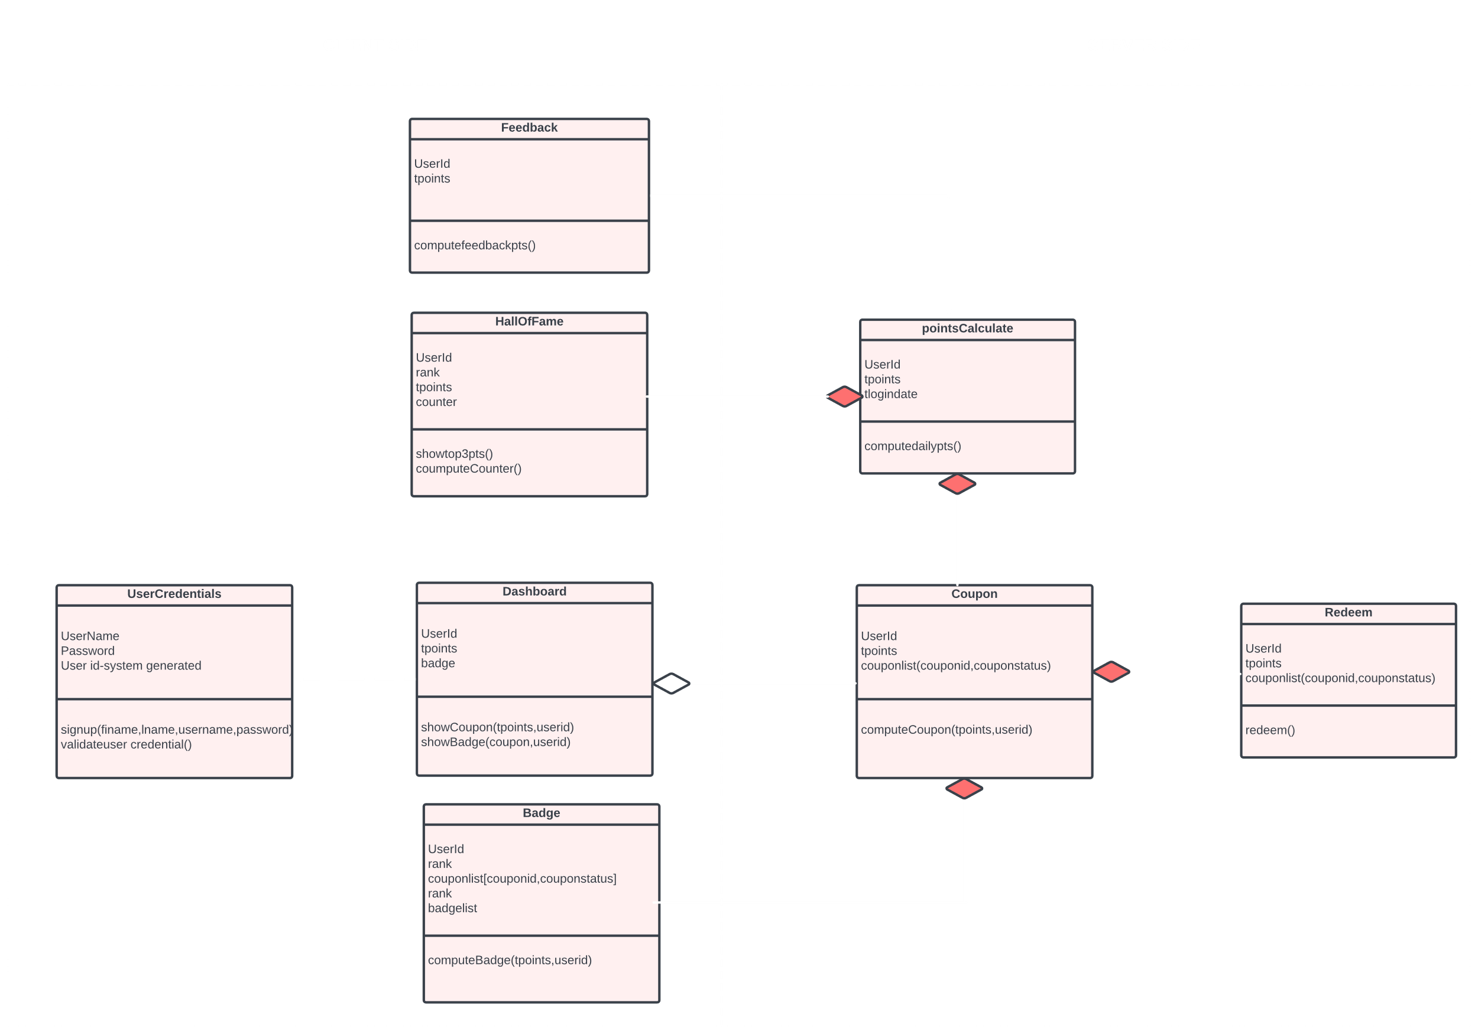
</System Model - Class Diagram

Slide 7

</Thank You

